Slide 1

MediAssist: Robotic Medication Companion for Elderly Care
Team Members:
Nikhilesh Gorrepati Vyshnavi Ryali Sai Shivani Vala

Slide 2
INTRODUCTION:
Robot applications are at an all-time high, and the medical industry is one such area where these robots could be deployed. Due to physical limits or cognitive problems, elderly people sometimes struggle to conduct daily duties alone. There is an immediate need for an Assistive Robot for Elderly Care that can physically aid with chores like fetching medicines, and assisting to enhance their quality of life and guarantee their well-being.
In the context of this project, the Fetch robot serves as a central element in a comprehensive task involving autonomous navigation, manipulation, and object recognition. The overarching goal is to leverage the capabilities of the Fetch robot to perform a specific task: picking up a medicine box from a table and autonomously navigating to a designated room to place the box. This project showcases the integration of complex robotic functionalities to solve a practical problem in a simulated environment.

Slide 3
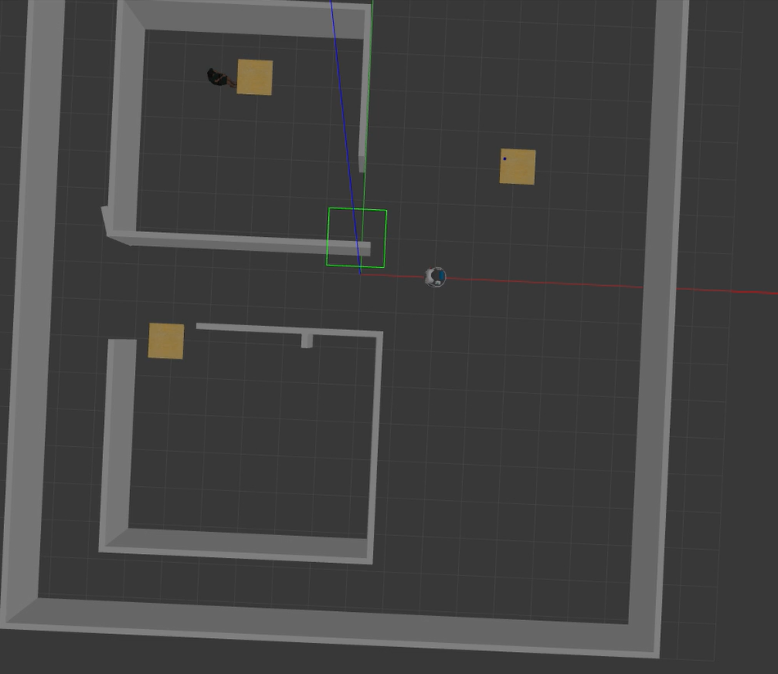
METHODOLOGY:
Simulation Environment:

Slide 4
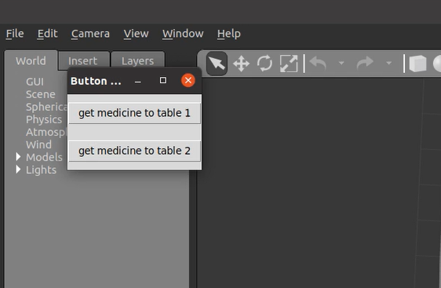
Choosing the Table: The GUI gives 2 options that is table in room 1 & 2 as drop locations.

Slide 5
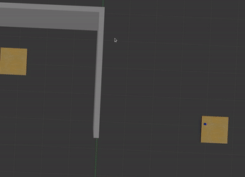
Navigation to the Table: The Fetch robot uses its navigation stack, including the base_trajectory_planner, to autonomously reach a designated table where the medicine box is located.

Slide 6
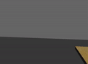
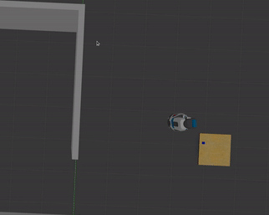
Object Perception: The robot employs sensors and perception algorithms to identify and locate the medicine box on the table. This step showcases the robot's ability to interact with its environment through visual recognition. The script utilizes basic grasping perception to find graspable objects on a table. It makes use of the grasping_msgs and moveit_python packages.

Slide 7
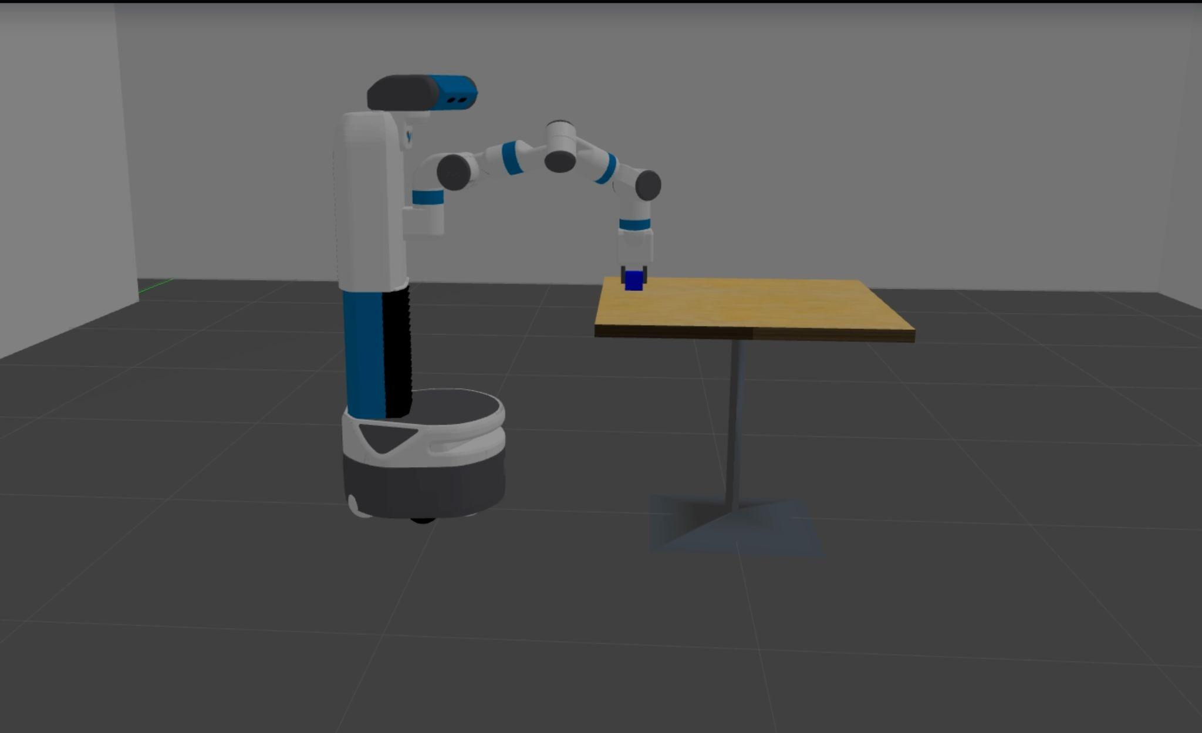
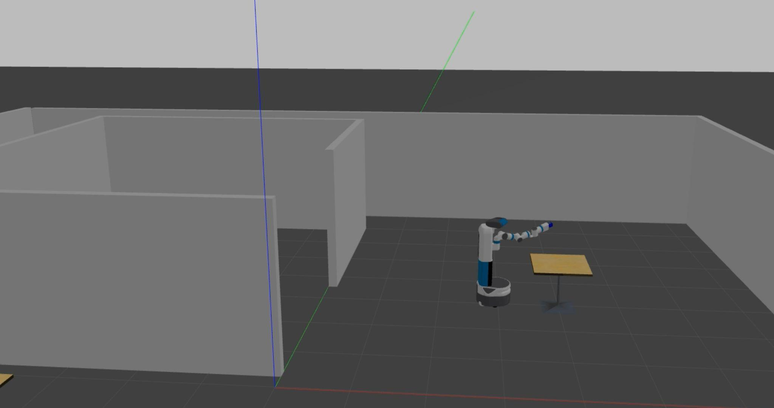
Object Manipulation: Using its manipulation arm and gripper, the Fetch robot grasps the medicine box securely. The grasping action demonstrates the precision and control capabilities of the robot's manipulator.

Slide 8
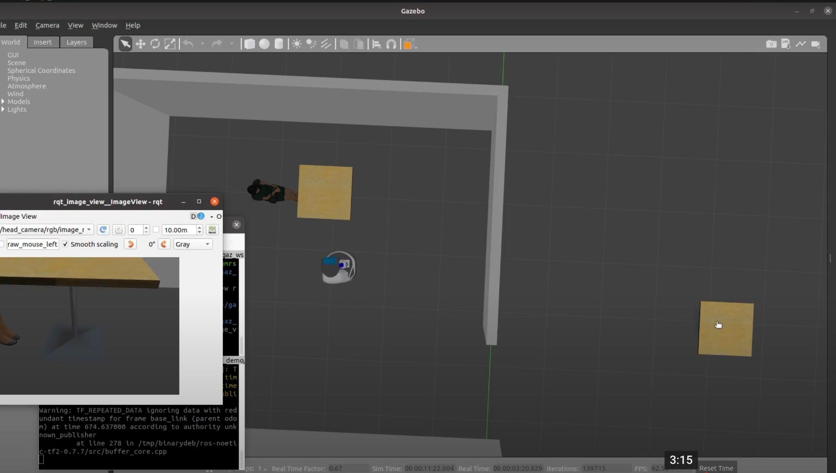
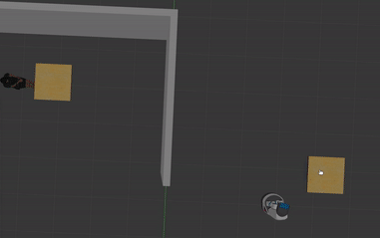
Autonomous Navigation to the Room: After picking up the medicine box, the robot plans a trajectory to autonomously navigate to a predefined room. This showcases the integration of navigation and manipulation tasks.

Slide 9
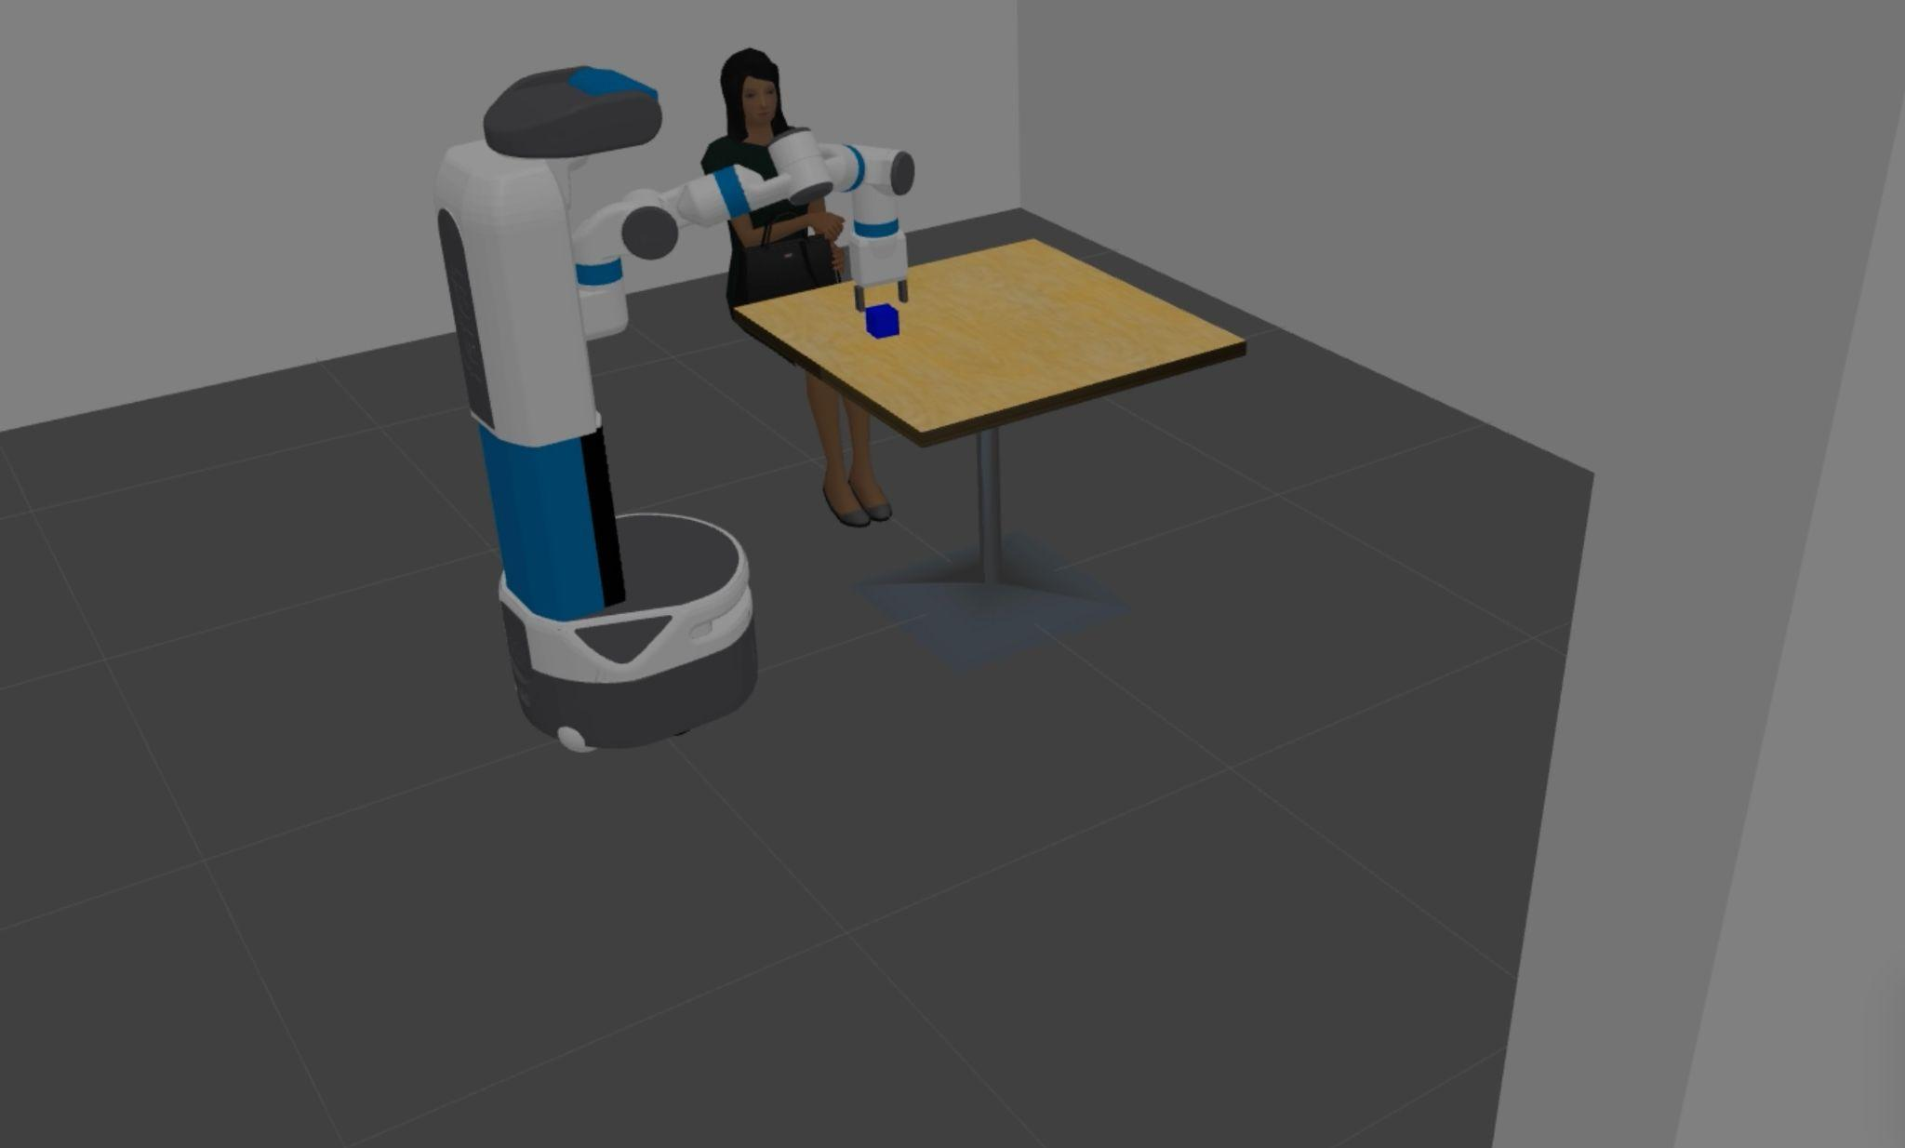
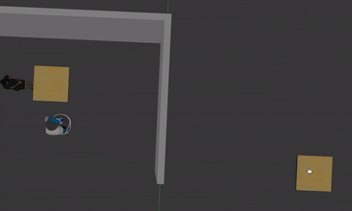
Object Placement: Upon reaching the room, the robot places the medicine box in a predetermined location, completing the overall task. This step demonstrates the successful coordination of perception, manipulation, and navigation.

Slide 10

DEMO:

Slide 11
REFERENCES:
Fetch Mobile Manipulator (wevolver.com)
Fetch & Freight Manual — Fetch & Freight Research Edition Melodic documentation (fetchrobotics.com)

Slide 12
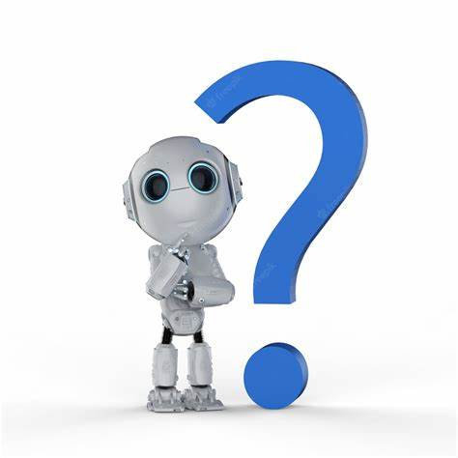

Slide 13
